Slide 1

Notes:
In 2018, in China, there were two rounds of competition held of a team of elite neuro surgeons against a neuroimaging AI system called BioMind. This AI system beat human doctors in neuroimaging recognition contest with a 2:0 score.
Walmart, the world’s largest retailer, supposedly found out that there are certain times at which beer and diapers sell particularly well together – when on Friday evenings young men make a last dash to the supermarket to get beer and their wives call after them, “Pick up some diapers, too, honey!”
“Some of the ways Wal-Mart managers found to exploit their findings are legendary. One such legend is the story, “diapers and beer”. Wal-Mart discovered through data mining that the sales of diapers and beer were correlated on Friday nights. It determined that the correlation was based on working men who had been asked to pick up diapers on their way home from work. On Fridays the men figured they deserved a six-pack of beer for their trouble; hence the connection between beer and diapers. By moving these two items closer together, Wal-Mart reportedly saw the sales of both items increase geometrically.”

Slide 2

Topics
Correlation Analysis
Contingency Table
Data Visualizations (Bar, Scatter, Line)
Introduction to Kaggle and Anaconda

Slide 3
Correlation Analysis

Slide 4
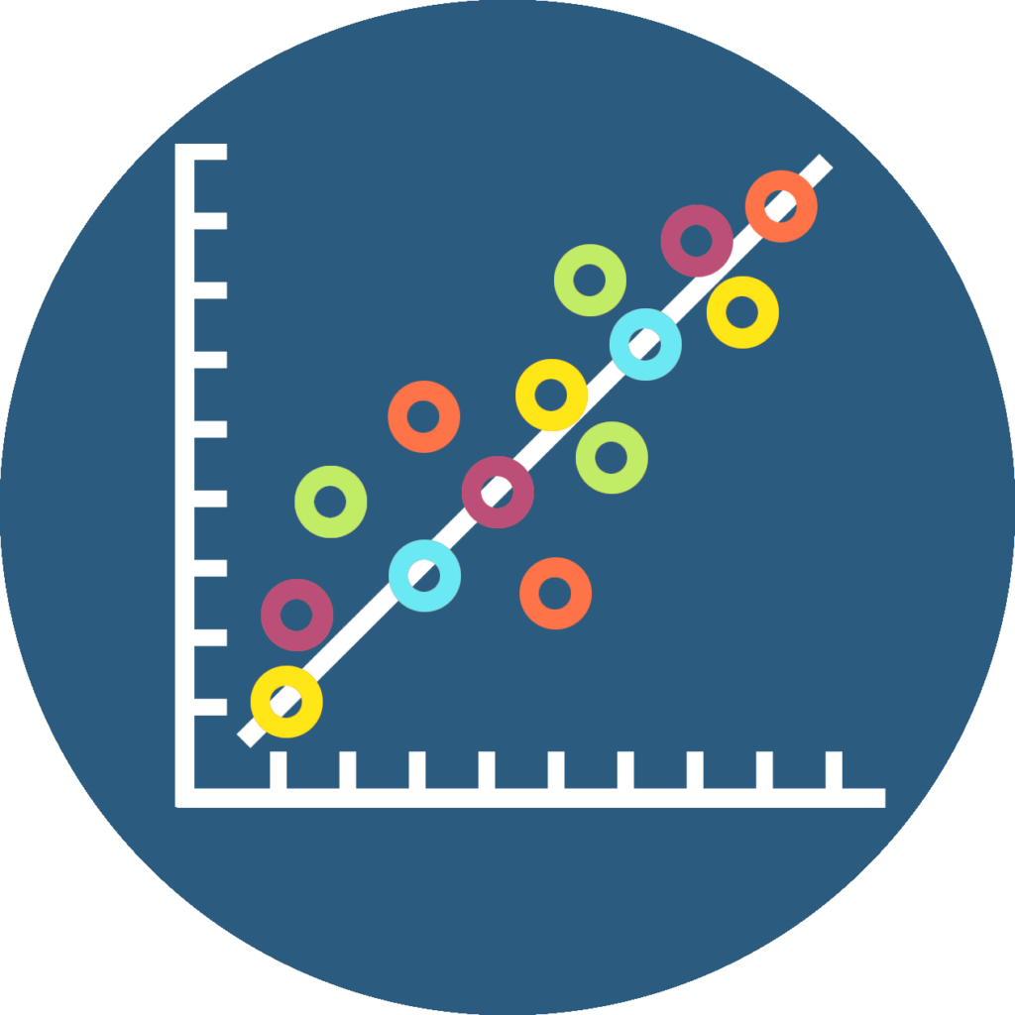
What is Correlation?
Correlation Analysis deals with association between two or more variables
The degree of relationship between the variables under consideration is measured
The measure of correlation, “Correlation Coefficient” summarizes in one figure the direction and strength of correlation

Slide 5
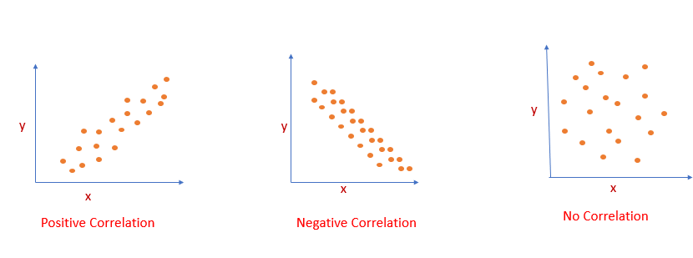
Types of Correlation?
Notes:
Positive Correlation
If both variables vary in same direction
Negative Correlation
If both variables vary in opposite direction
Zero Correlation
No trend

Slide 6
Correlation VS Causality

Slide 7
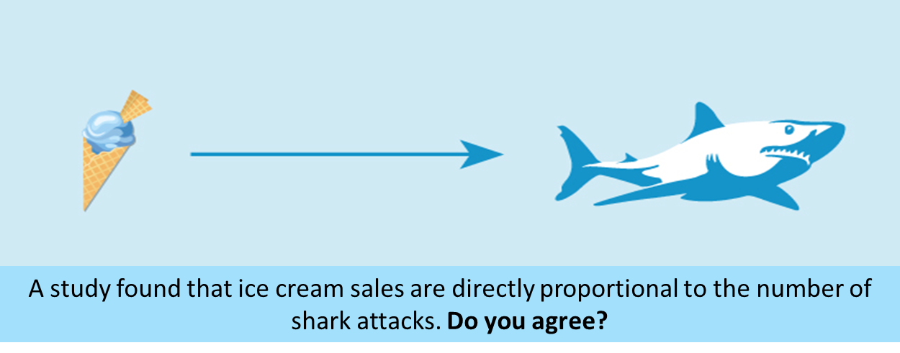
Notes:
If yes, then does an increase in ice cream sales mean more shark attacks?

Slide 8
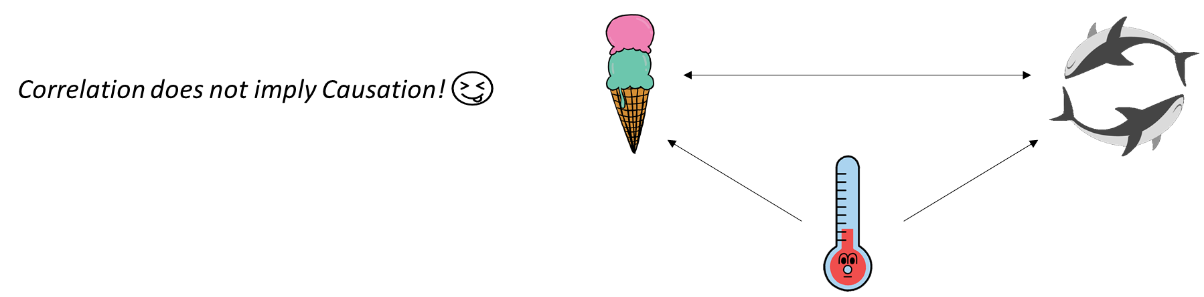
Notes:
Correlation does not imply causation.
Temperature is the confounding factor that increases ice cream sales and causes the shark to attack as many people will be going to the beach in hot weather.

Slide 9
Types of Correlation Coefficients?
Pearson’s Coefficients
Spearman Rank
Kendall Tau

Slide 10
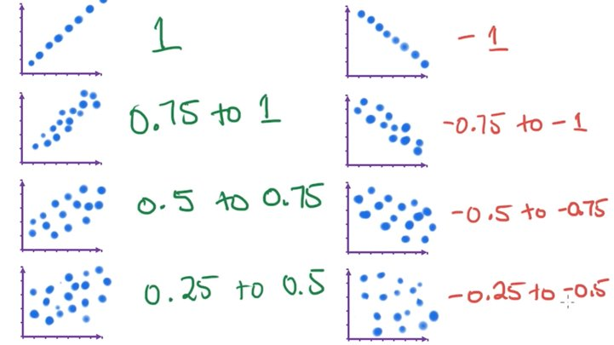
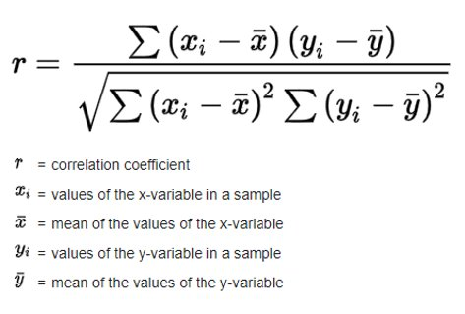
Pearson's Coefficient
Linear Relationship
Numeric Variables

Slide 11
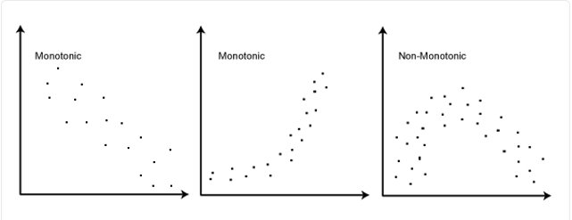
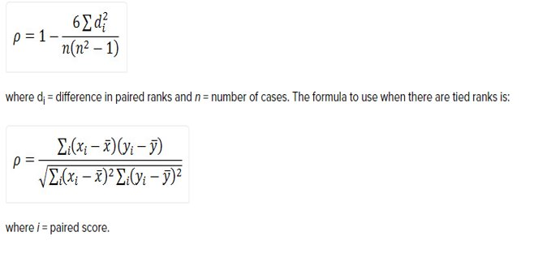
Spearman Rank
Monotonic Relationship
Numeric and Ordinal Variables

Slide 12
Kendall Tau's
Ordinal Association between two variables
Example:
exam grade vs hours spent revising
customer satisfaction vs delivery of time

Slide 13
How to choose?
If the data is continuous and normally distributed, use Pearson correlation.
If the data is ordinal or non-normal, use Spearman rank correlation.
If the data is ordinal or nominal, use Kendall Tau.

Slide 14
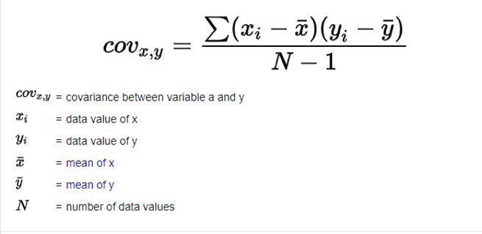
What is Covariance?
Determines the direction of relationship but not the strength.
Prior step of calculating Pearson's Coefficient.

Slide 15
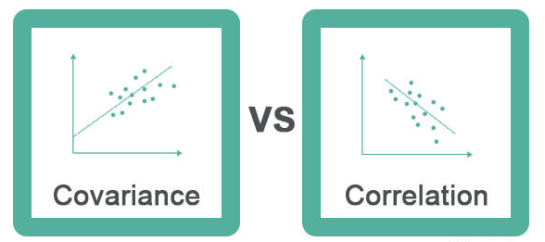
Notes:
Covariance is an indicator of how two random variables change concerning each other. Correlation, on the other hand, measures the strength of this relationship.
https://www.wallstreetmojo.com/correlation-vs-covariance/

Slide 16
Contingency Table

Slide 17
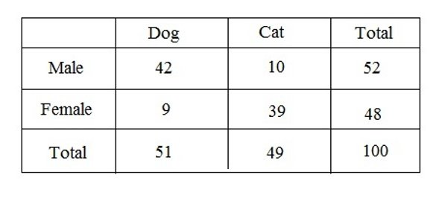
What is Contingency Table?
Contingency Table consists of a collection of cells containing counts.
Purpose of Contingency Table is to summarize large sets of data
Used to summarize the relationship between several categorical variables

Slide 18
Data Visualizations

Slide 19
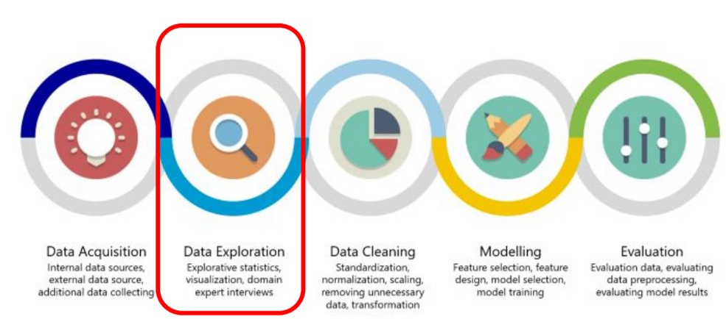
Data Science Workflow

Slide 20
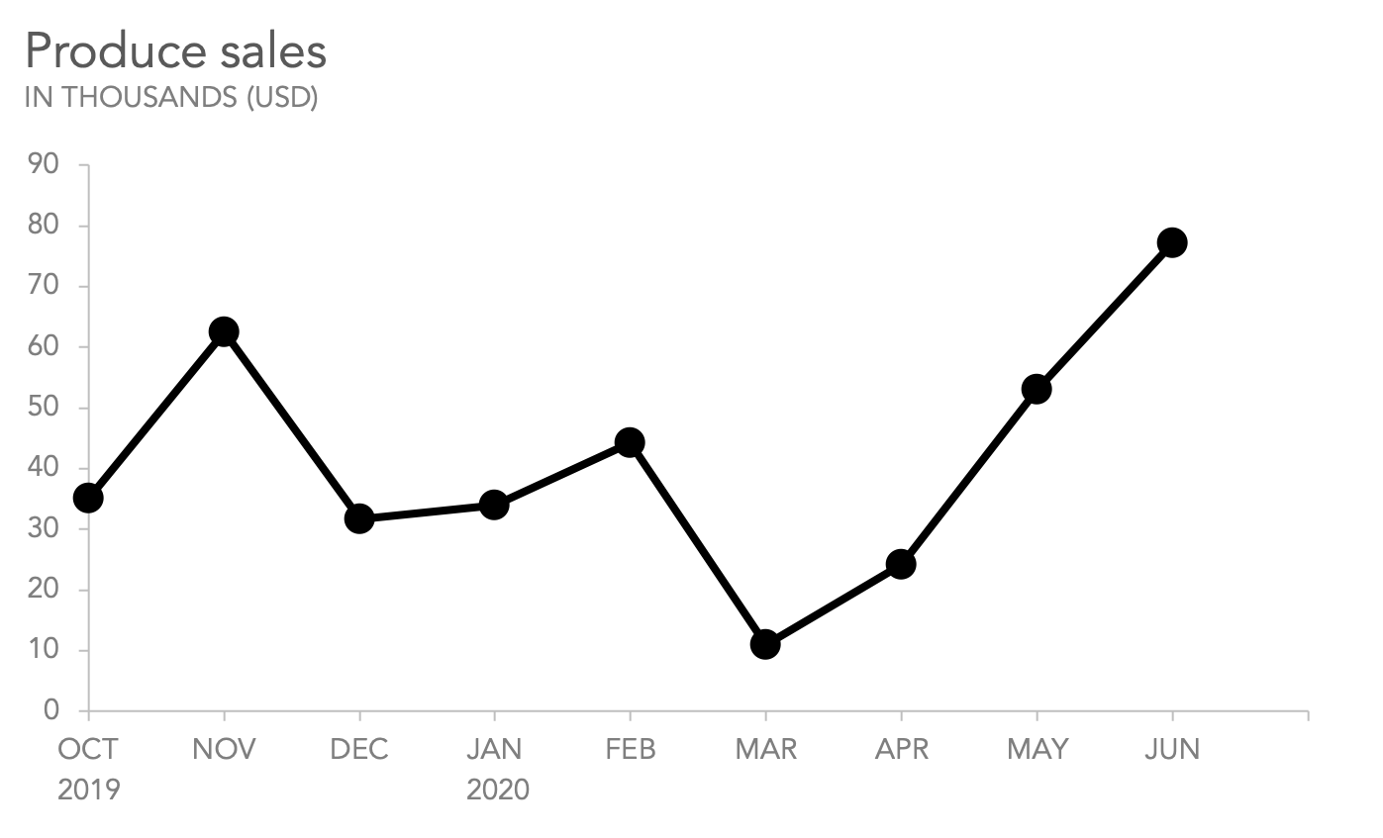
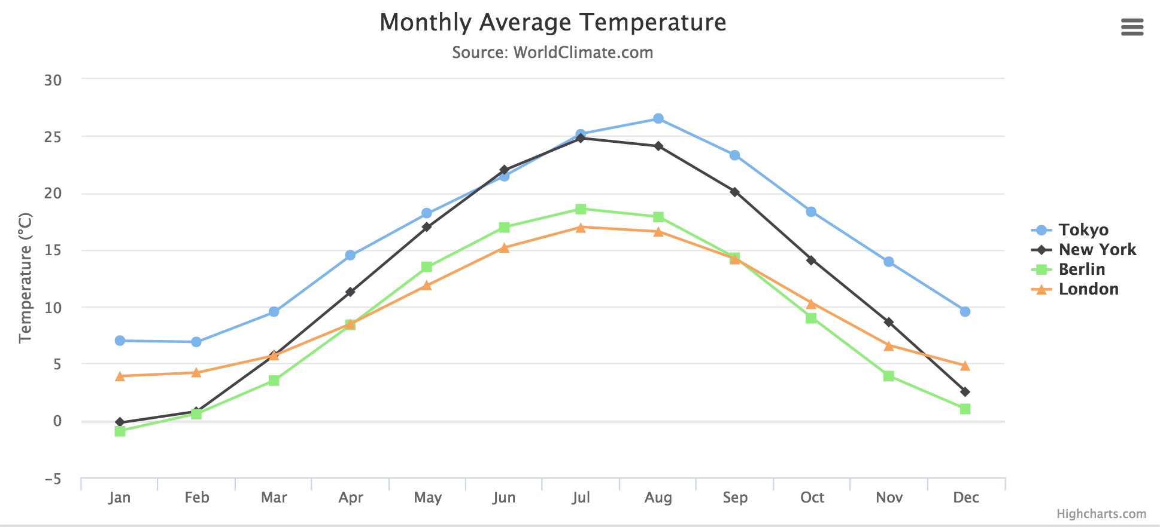
Line Graph
A line graph, also known as a line chart or a line plot, is commonly drawn to show information that changes over time.
a) Line Graph
b) Multi-Line Graph

Slide 21
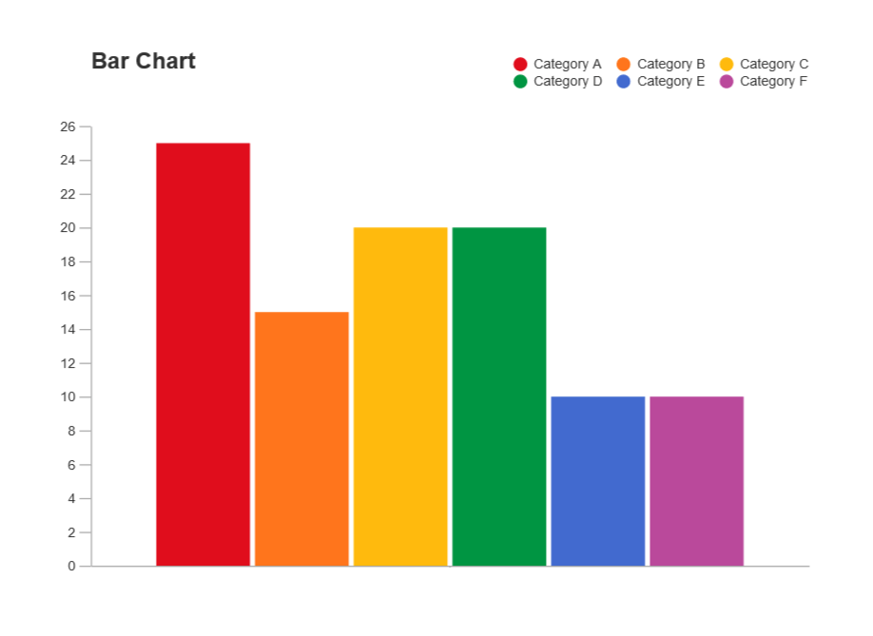
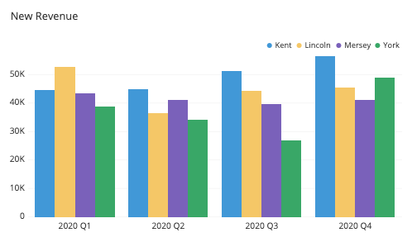
Bar Graph
A bar graph is a graph that shows complete data with rectangular bars and the heights of bars are proportional to the values that they represent.
a) Bar Graph
b) Grouped Bar Graph

Slide 22
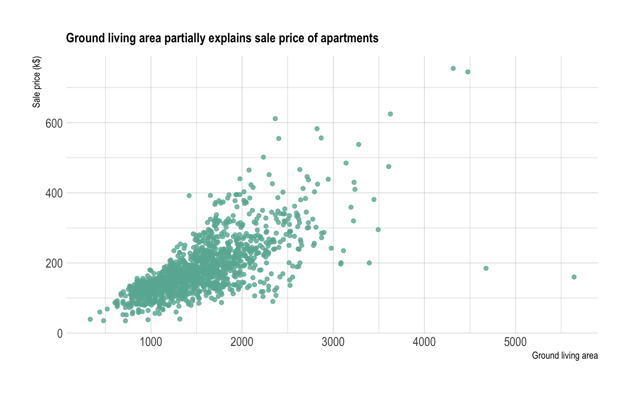
Scatter Plot
A scatter plot (aka scatter chart, scatter graph) uses dots to represent values for two different numeric variables.

Slide 23
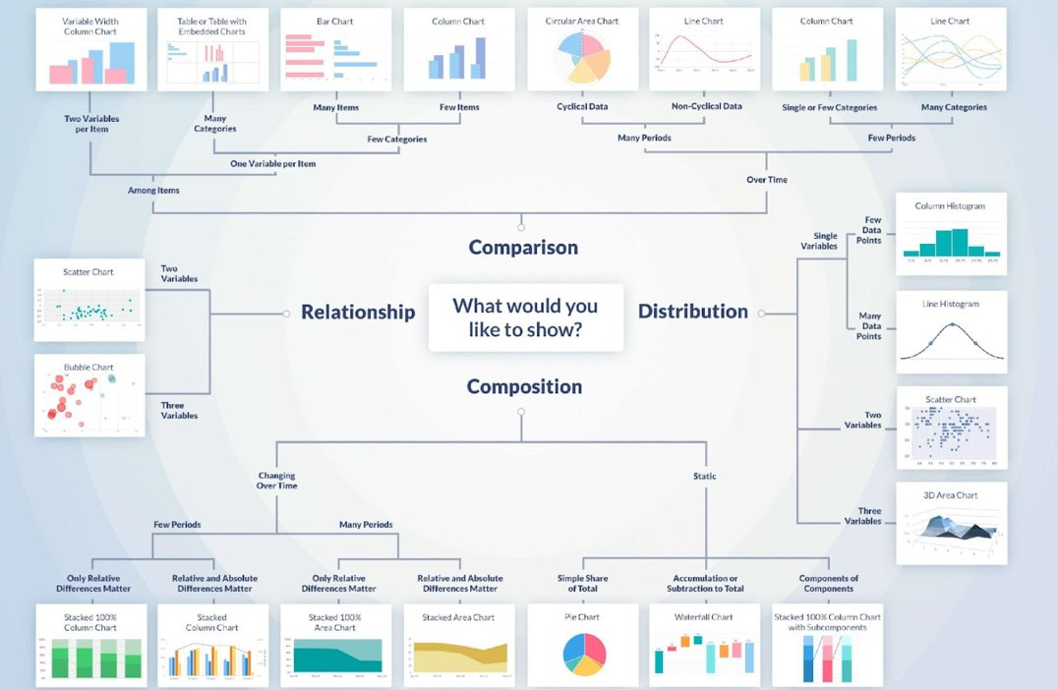

Slide 24


&

Slide 25

THANK YOU
Training and Certification

